Slide 1

Design Patterns
Strategy Pattern
Jens Devriendt & Sanne vermeiren

Slide 2

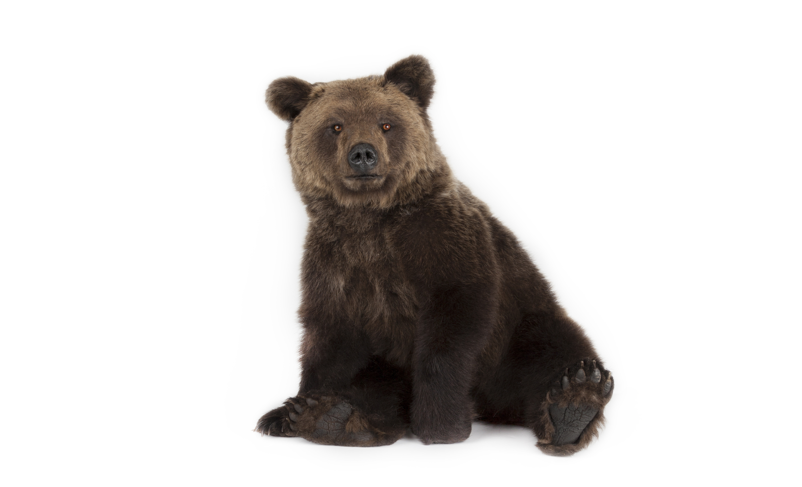
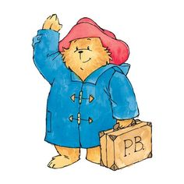
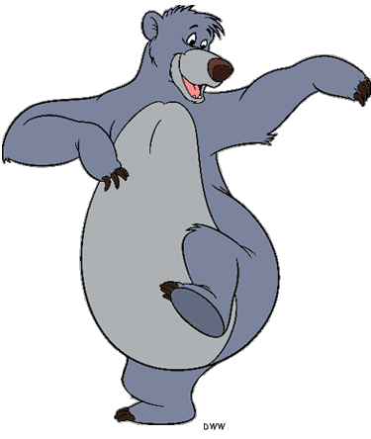
We’ll ROARRRR your socks off!
… but we’ll rather sing or talk

Slide 3
What is a bear
Physical appearance
Eats

Slide 4
Bear
Superclass (abstract)
Eat ()
Display ()
Abstract: all bears look different
Grizzly bear
Baloo bear
Display () {
Display () {

Slide 5
But bears also…
Move
Make noise

Slide 6
Bear
Superclass (abstract)
Eat ()
Display ()
Roarr ()
WalkOnFourLegs ()
Abstract: all bears look different
Grizzly bear
Baloo bear
All bears inherit everything
-> Cartoon bears walk and talk differently
? Override everything…
Display () {
Display () {

Slide 7
Design rule
1
Separate all elements that stay the same from those who differ

Slide 8
Bear
Superclass (abstract)
Eat ()
Display ()
WalkBehavior ()
RoarBehavior()
Abstract: all bears look different
Walk Behavior
Roar Behavior
Interface
Interface
Public void walk()
Public void roar()

Slide 9
Bear
Superclass (abstract)
Eat ()
Display ()
WalkBehavior ()
RoarBehavior()
Walk Behavior
Roar Behavior
Interface
Interface
Public void walk()
Public void roar()
Walk like a bear
Walk like a cartoon
Roar like a bear
Talk like a bear
Implement Walk Behavior
Implement Walk Behavior
Implement Roar Behavior
Implement Roar Behavior
Public void walk()
Public void walk()
Public void talk()
Public void talk()

Slide 10
Design rule
2
Choose composition over inheritance

Slide 11
Let’s program Baloo Bear!
Walks like a cartoon
Talking bear

Slide 12
Bear
Superclass (abstract)
Eat ()
Display ()
WalkBehavior ()
RoarBehavior()
Baloo Bear
Extends bear
Walkbehavior = new WalksLikeACartoon ();
RoarBehavior = new TalkingBear ();

